Slide 1
Postgre SQL

Slide 2
Select
SELECT column1, column2, ... FROM table_name;
SELECT * FROM table_name;

Slide 3
Select Example:
SELECT "UserID","Username" FROM public."Users"
SELECT * FROM public."Users“

Slide 4
Select Distinct
SELECT DISTINCT column1, column2, ... FROM table_name;
SELECT DISTINCT * FROM table_name;

Slide 5
Select Distinct Example:
SELECT DISTINCT "UserID","Username" FROM public."Users";
SELECT DISTINCT * FROM public."Users";

Slide 6
Where
SELECT column1, column2, ... FROM table_name WHERE condition;

Slide 7
Where Example:
SELECT * FROM public."Users" WHERE "UserID" = 5;

Slide 8
And, Or, Not Operators
SELECT column1, column2, ... FROM table_name WHERE condition1 AND condition2 AND condition3 ...;

Slide 9
And, Or, Not Operators
SELECT column1, column2, ... FROM table_name WHERE condition1 OR condition2 OR condition3 ...;

Slide 10
And, Or, Not Operators
SELECT column1, column2, ... FROM table_name WHERE NOT condition;

Slide 11
Order By
SELECT column1, column2, ... FROM table_name ORDER BY column1, column2, ... ASC|DESC;

Slide 12
Order By Example:
SELECT * FROM public."Users" ORDER BY "UserID" ASC;
SELECT * FROM public."Users" ORDER BY "UserID" DESC;

Slide 13
Insert Into
INSERT INTO table_name (column1, column2, column3, ...) VALUES (value1, value2, value3, ...);
INSERT INTO table_name VALUES (value1, value2, value3, ...);

Slide 14
Insert Into
INSERT INTO public."Users" ("UserID", "Username", "Email", "Password", "CreatedAt") VALUES (1, 'john_doe', 'john.doe@example.com', 'password123', '2023-07-23 12:00:00'), (2, 'jane_smith', 'jane.smith@example.com', 'abcde456', '2023-07-23 13:30:00'), (3, 'bob_johnson', 'bob.johnson@example.com', 'pass321', '2023-07-23 14:45:00'), (4, 'mary_white', 'mary.white@example.com', 'qwerty789', '2023-07-23 15:15:00'), (5, 'sam_brown', 'sam.brown@example.com', 'securepass', '2023-07-23 16:00:00');

Slide 15
Null Values
SELECT column_names FROM table_name WHERE column_name IS NULL;
SELECT column_names FROM table_name WHERE column_name IS NOT NULL;

Slide 16
Null Functions: IFNULL(), ISNULL(), COALESCE(), and NVL()
Problem: Suppose that the "UnitsOnOrder" column is optional, and may contain NULL values.
SELECT ProductName, UnitPrice * (UnitsInStock + UnitsOnOrder) FROM Products;

Slide 17
Null Functions: IFNULL(), ISNULL(), COALESCE(), and NVL()
Solution:
Return the first non-null value in a list: SELECT COALESCE(NULL, NULL, NULL, 'W3Schools.com', NULL, 'Example.com’);
SELECT ProductName, UnitPrice * (UnitsInStock + IFNULL(UnitsOnOrder, 0)) FROM Products;
SELECT ProductName, UnitPrice * (UnitsInStock + COALESCE(UnitsOnOrder, 0)) FROM Products;

Slide 18
Update
UPDATE table_name SET column1 = value1, column2 = value2, ... WHERE condition;

Slide 19
Update Example:
UPDATE public."Users" SET "Password" = 'secure123' WHERE "UserID" = 5;

Slide 20
Delete (Drop) Table
DROP TABLE table_name;

Slide 21
Delete (Drop) Table Example:
DROP TABLE public."Users";

Slide 22
Delete Statement
DELETE FROM table_name WHERE condition;
DELETE FROM table_name;

Slide 23
Delete Statement Example:
DELETE FROM public."Users" WHERE "UserID"=1;

Slide 24
Min Max
SELECT MIN(column_name) FROM table_name WHERE condition;
SELECT MAX(column_name) FROM table_name WHERE condition;

Slide 25
Min Max Example:
SELECT MIN("UserID") FROM public."Users";
SELECT MAX("UserID") FROM public."Users";

Slide 26
Count Avg Sum
SELECT COUNT(column_name) FROM table_name WHERE condition;
SELECT AVG(column_name) FROM table_name WHERE condition;
SELECT SUM(column_name) FROM table_name WHERE condition;

Slide 27
Count Avg Sum Example:
SELECT COUNT(*) FROM public."Users";
SELECT AVG("UserID") FROM public."Users";
SELECT SUM("UserID") FROM public."Users";

Slide 28
Like
SELECT column1, column2, ... FROM table_name WHERE columnN LIKE pattern;

Slide 29
Like Example:
SELECT "UserID", "Username“ FROM public."Users“ WHERE "Username" LIKE '%j%’;
SELECT "UserID", "Username“ FROM public."Users“ WHERE "Username" LIKE '_a%’;
SELECT "UserID", "Username“ FROM public."Users“ WHERE "Username" NOT LIKE '_a%';

Slide 30
In
SELECT column_name(s) FROM table_name WHERE column_name IN (value1, value2, ...);
SELECT column_name(s) FROM table_name WHERE column_name IN (SELECT STATEMENT);

Slide 31
In Example:
SELECT * FROM Customers WHERE Country IN ('Germany', 'France', 'UK’);
SELECT * FROM Customers WHERE Country NOT IN ('Germany', 'France', 'UK’);
SELECT * FROM public."Users“
WHERE "Password" IN ('securepass', 'qwerty789');

Slide 32
Between
SELECT column_name(s) FROM table_name WHERE column_name BETWEEN value1 AND value2;

Slide 33
Between Example:
SELECT * FROM public."Users“ WHERE "UserID" BETWEEN 3 AND 5;
SELECT * FROM public."Users“ WHERE "UserID" NOT BETWEEN 3 AND 5;
SELECT * FROM public."Users“ WHERE "CreatedAt" BETWEEN '13:30:00+03:00' AND '15:15:00+03:00';

Slide 34
Between with In Example:
SELECT * FROM public."Users“ WHERE "UserID" BETWEEN 3 AND 5 AND "Password" IN ('securepass', 'qwerty789');

Slide 35
Aliases
SELECT column_name AS alias_name FROM table_name;
SELECT column_name(s) FROM table_name AS alias_name;

Slide 36
Aliases Example:
SELECT "Username" AS "Name", "Email" AS "Communication Email" FROM public."Users";
SELECT CONCAT("Username" , ', ' , "Email") AS "Person“ FROM public."Users";
SELECT "U"."UserID", "U"."Username", "C"."Name" FROM public."Users" AS "U", public."Conversations" AS "C";

Slide 37
Aliases Advantages:
Aliases can be useful when:
There are more than one table involved in a query (same name)
Functions are used in the query
Column names are big or not very readable
Two or more columns are combined together

Slide 38
Joins

Slide 39

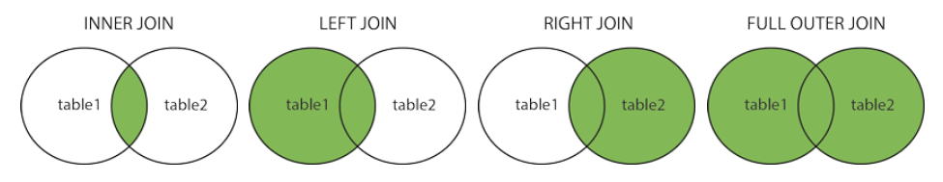
Join Types
(INNER) JOIN: Returns records that have matching values in both tables
LEFT (OUTER) JOIN: Returns all records from the left table, and the matched records from the right table
RIGHT (OUTER) JOIN: Returns all records from the right table, and the matched records from the left table
FULL (OUTER) JOIN: Returns all records when there is a match in either left or right table

Slide 40
Inner Join
SELECT column_name(s) FROM table1 INNER JOIN table2 ON table1.column_name = table2.column_name;

Slide 41
Inner Join Example:
SELECT * FROM public."Users" INNER JOIN public."UserConversation" ON public."Users"."UserID" = public."UserConversation"."UserID";
SELECT * FROM ((public."Users" INNER JOIN public."UserConversation " ON public."Users"."UserID" = public."UserConversation"."UserID") INNER JOIN public."Messages " ON public."Users"."UserID" = public."Messages"."UserID");

Slide 42
Left Join
SELECT column_name(s) FROM table1 LEFT JOIN table2 ON table1.column_name = table2.column_name;

Slide 43
Left Example:
https://www.w3schools.com/sql/sql_join_left.asp

Slide 44
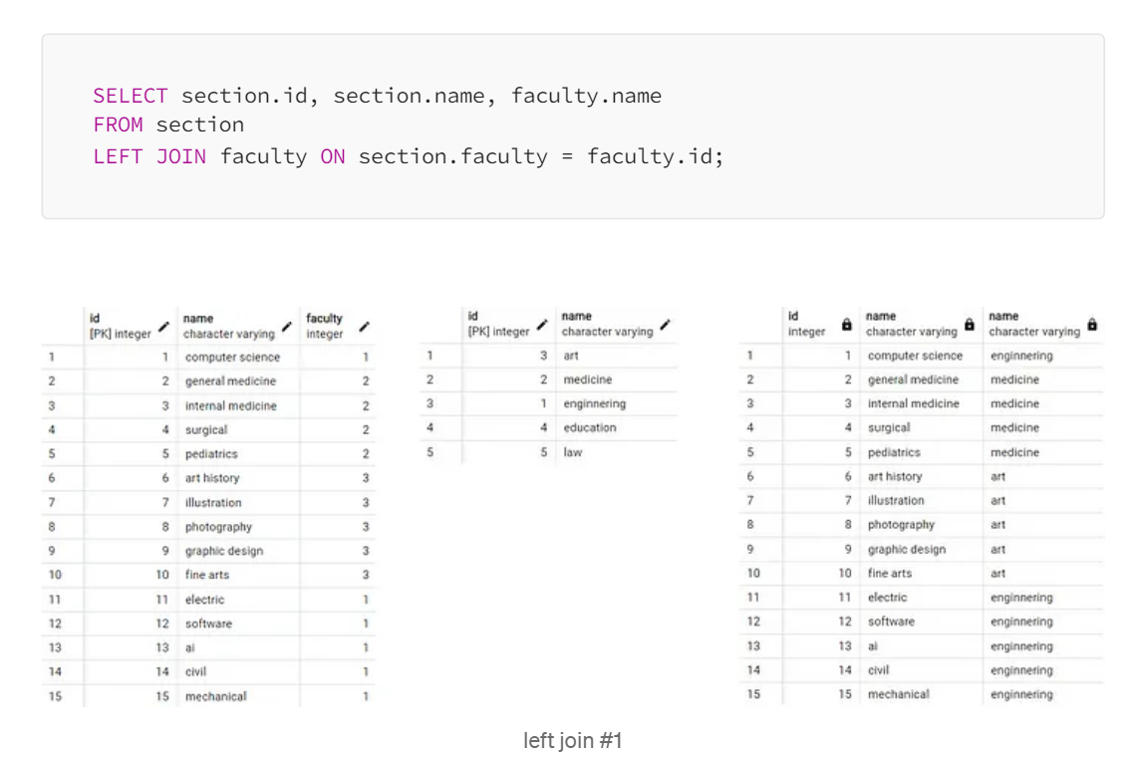
Left Join Example:
The LEFT JOIN keyword returns all records from the left table (setion), even if there are no matches in the right table (faculty).

Slide 45
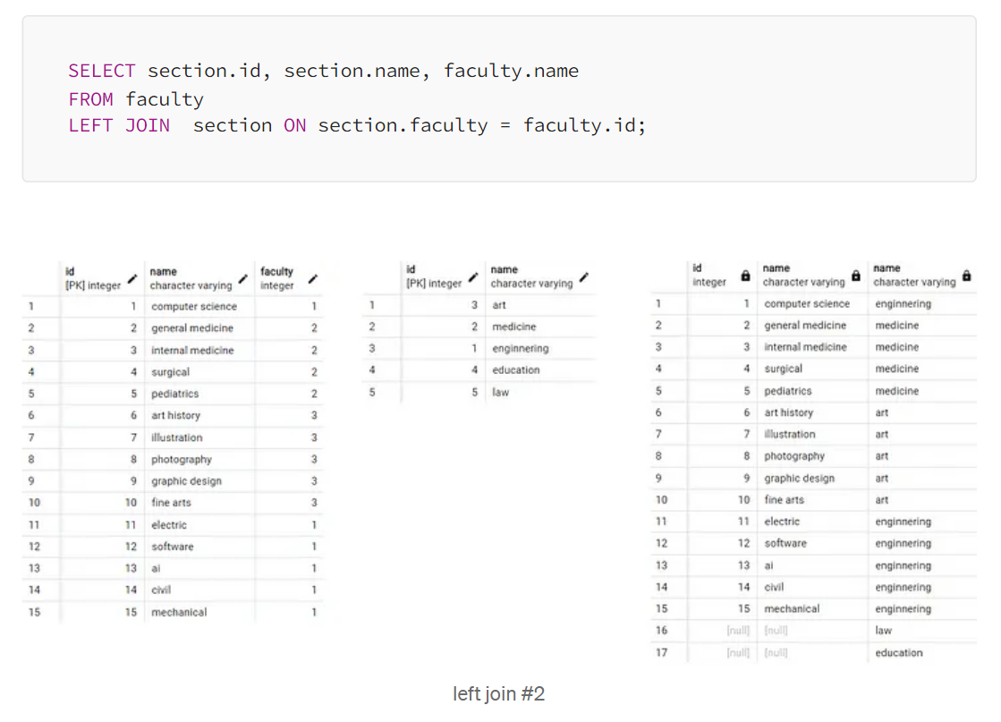
Left Join Example:
The LEFT JOIN keyword returns all records from the left table (faculty), even if there are no matches in the right table (section).

Slide 46
Right Join
SELECT column_name(s) FROM table1 RIGHT JOIN table2 ON table1.column_name = table2.column_name;

Slide 47
Right Example:
https://www.w3schools.com/sql/trysql.asp?filename=trysql_select_join_right&ss=-1

Slide 48
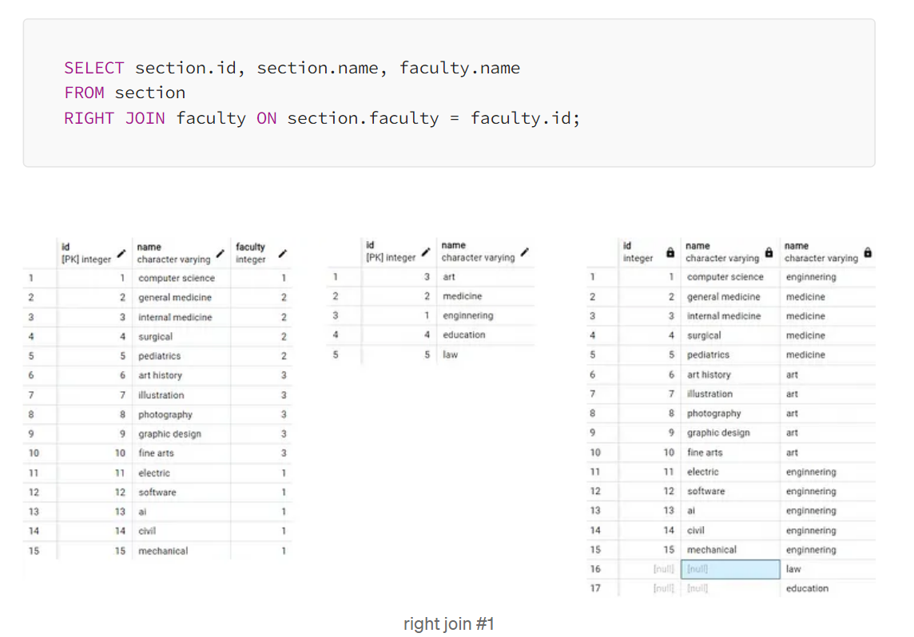
Right Join Example:
The RIGHT JOIN keyword returns all records from the right table (faculty), even if there are no matches in the left table (section).

Slide 49
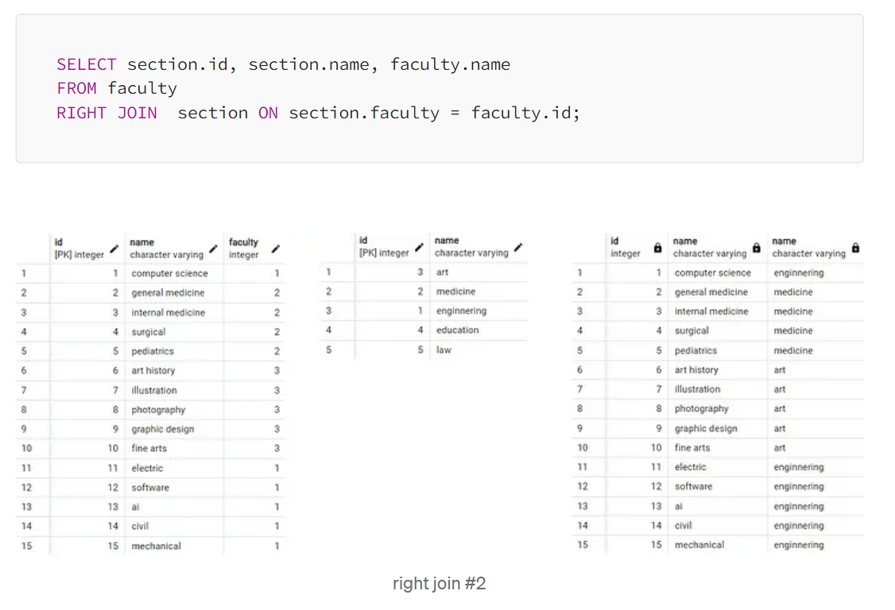
Right Join Example:
The RIGHT JOIN keyword returns all records from the right table (section), even if there are no matches in the left table (faculty).

Slide 50
Full Join
SELECT column_name(s) FROM table1 FULL OUTER JOIN table2 ON table1.column_name = table2.column_name WHERE condition;

Slide 51
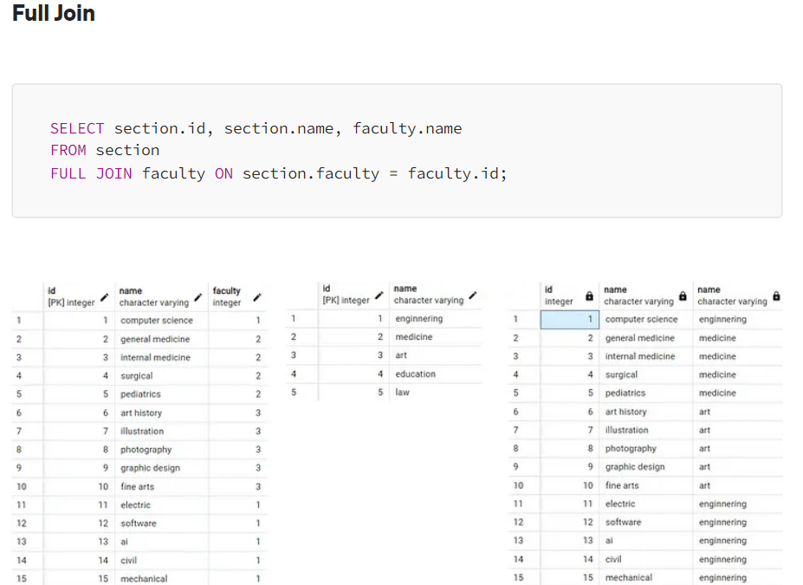
Full Join Example:
Note: The FULL JOIN keyword returns all matching records from both tables whether the other table matches or not.

Slide 52
Self Join
SELECT column_name(s) FROM table1 T1, table1 T2 WHERE condition;

Slide 53
Self Join
https://www.w3schools.com/sql/trysql.asp?filename=trysql_select_join_self

Slide 54
Union
SELECT column_name(s) FROM table1 UNION SELECT column_name(s) FROM table2;
SELECT column_name(s) FROM table1 UNION ALL SELECT column_name(s) FROM table2;

Slide 55
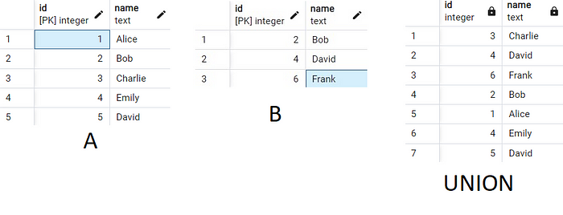
Union Example:
SELECT id, name FROM public."A" UNION SELECT id, name FROM public."B";

Slide 56
Intersect
SELECT column_name(s) FROM table1 INTERSECT SELECT column_name(s) FROM table2;

Slide 57
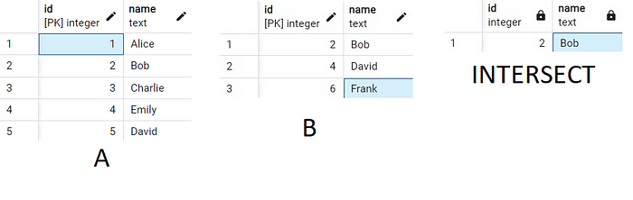
Intersect Example:
SELECT id, name FROM public."A" INTERSECT SELECT id, name FROM public."B";

Slide 58
Group By
SELECT column_name(s) FROM table_name WHERE condition GROUP BY column_name(s) ORDER BY column_name(s);

Slide 59
Group By Example:
https://www.w3schools.com/sql/trysql.asp?filename=trysql_select_groupby

Slide 60
Having
SELECT column_name(s) FROM table_name WHERE condition GROUP BY column_name(s) HAVING condition ORDER BY column_name(s);

Slide 61
Having
The HAVING clause was added to SQL because the WHERE keyword cannot be used with aggregate functions.

Slide 62
Having Example:
https://www.w3schools.com/sql/trysql.asp?filename=trysql_select_having

Slide 63
Exists
The EXISTS operator returns TRUE if the subquery returns one or more records.
SELECT column_name(s) FROM table_name WHERE EXISTS (SELECT column_name FROM table_name WHERE condition);

Slide 64
Exists Example:
SELECT "Username" FROM public."Users" WHERE EXISTS(SELECT * FROM public."Users" WHERE "UserID" <= 5);
SELECT * FROM public."UserConversation" WHERE EXISTS (SELECT * FROM public."Users" WHERE public."Users"."UserID" = public."UserConversation"."UserID");

Slide 65
Any
The ANY operator: returns a boolean value as a result returns TRUE if ANY of the subquery values meet the condition
SELECT column_name(s) FROM table_name WHERE column_name operator ANY (SELECT column_name FROM table_name WHERE condition);
Note: The operator must be a standard comparison operator (=, <>, !=, >, >=, <, or <=).

Slide 66
Any Example:
https://www.w3schools.com/sql/trysql.asp?filename=trysql_select_any&ss=-1

Slide 67
All
The ALL operator: returns a boolean value as a result returns TRUE if ALL of the subquery values meet the condition is used with SELECT, WHERE and HAVING statements
SELECT ALL column_name(s) FROM table_name WHERE condition;
Note: The operator must be a standard comparison operator (=, <>, !=, >, >=, <, or <=).

Slide 68
All
The ALL operator: returns a boolean value as a result returns TRUE if ALL of the subquery values meet the condition is used with SELECT, WHERE and HAVING statements
SELECT column_name(s) FROM table_name WHERE column_name operator ALL (SELECT column_name FROM table_name WHERE condition);
Note: The operator must be a standard comparison operator (=, <>, !=, >, >=, <, or <=).

Slide 69
All Example:
SELECT ALL * FROM public."Users" WHERE TRUE;

Slide 70
All Example:
https://www.w3schools.com/sql/trysql.asp?filename=trysql_select_all3&ss=-1

Slide 71
Select Into
It creates new table (if table already exist, it gives error).
SELECT * INTO newtable [IN externaldb] FROM oldtable WHERE condition;
SELECT column1, column2, column3, ... INTO newtable [IN externaldb] FROM oldtable WHERE condition;

Slide 72
Select Into Example:
SELECT * INTO public."Users2" FROM public."Users";
SELECT * INTO public."Users2" FROM public."Users" WHERE TRUE;
SELECT * INTO public."Users2" FROM public."Users" WHERE false; (same WHERE 1 = 0;)

Slide 73
Select Into Tip:
SELECT INTO can also be used to create a new, empty table using the schema of another. Just add a WHERE clause that causes the query to return no data:
SELECT * INTO newtable FROM oldtable WHERE 1 = 0;

Slide 74
Insert Into Select
The INSERT INTO SELECT statement copies data from one table and inserts it into exist another table(not new table).
The INSERT INTO SELECT statement requires that the data types in source and target tables match.
Note: The existing records in the target table are unaffected.

Slide 75
Insert Into Select
INSERT INTO table2 SELECT * FROM table1 WHERE condition;
INSERT INTO table2 (column1, column2, column3, ...) SELECT column1, column2, column3, ... FROM table1 WHERE condition;

Slide 76
Case
If there is no ELSE part and no conditions are true, it returns NULL.
CASE WHEN condition1 THEN result1 WHEN condition2 THEN result2 WHEN conditionN THEN resultN ELSE result END;

Slide 77
Case Example:
SELECT *
FROM public."Users"
ORDER BY
(CASE
WHEN "Username" IS NULL THEN "Email"
ELSE "Username"
END);

Slide 78
Procedures
A stored procedure is a prepared SQL code that you can save, so the code can be reused over and over again.
So if you have an SQL query that you write over and over again, save it as a stored procedure, and then just call it to execute it.
You can also pass parameters to a stored procedure, so that the stored procedure can act based on the parameter value(s) that is passed.

Slide 79
Procedures
CREATE PROCEDURE procedure_name AS sql_statement GO;
EXEC procedure_name;

Slide 80
Procedure Example
CREATE PROCEDURE myProcedure()
LANGUAGE plpgsql
AS $$
BEGIN
RAISE NOTICE 'TEST PROCEDURE YAZISI';
END;
$$
CALL myProcedure()

Slide 81
Procedure Example
CREATE OR REPLACE PROCEDURE add_user(p1 integer, p2 text, p3 text, p4 text, p5 time)
LANGUAGE plpgsql
AS $$
BEGIN
INSERT INTO public."Users" ("UserID","Username", "Email", "Password", "CreatedAt")
VALUES (p1,p2,p3,p4,p5);
END;
$$
CALL add_user(6,'selena_gomez', 'selena.gomez@example.com', 'mypony', '2023-07-27 19:06:00');

Slide 82
Comments
SELECT * FROM Customers -- WHERE City='Berlin’;
SELECT CustomerName, /*City,*/ Country FROM Customers;

Slide 83
Operators
https://www.w3schools.com/sql/sql_operators.asp

Slide 84
Create Database
CREATE DATABASE databasename;

Slide 85
Create Database Example:
CREATE DATABASE "DbSchool"
WITH
OWNER = postgres
ENCODING = 'UTF8'
CONNECTION LIMIT = -1
IS_TEMPLATE = False;

Slide 86
Show Database
SELECT datname FROM pg_database;

Slide 87
Drop Database
DROP DATABASE databasename;

Slide 88
Drop Database Example:
DROP DATABASE "DbUniversity";
SELECT datname FROM pg_database WHERE datname = 'DbUniversity';

Slide 89
Backup
BACKUP DATABASE databasename TO DISK = 'filepath';

Slide 90
Backup

Slide 91
Create Table
CREATE TABLE table_name ( column1 datatype, column2 datatype, column3 datatype, .... );
CREATE TABLE new_table_name AS SELECT column1, column2,... FROM existing_table_name WHERE ....;

Slide 92
Create Table
Add existing table with data
CREATE TABLE public."UsersTest" AS SELECT * FROM public."Users";

Slide 93
Create Table Example:
CREATE TABLE public."Users" ( "UserID" integer NOT NULL, "Username" character varying(20), "Email" character varying(45), "Password" character varying(45), "CreatedAt" time with time zone, PRIMARY KEY ("UserId") ); ALTER TABLE IF EXISTS public."Users" OWNER to postgres;

Slide 94

Delete (Drop) Table
DROP TABLE table_name;

Slide 95
Delete (Drop) Table Example:
DROP TABLE public."Users";

Slide 96
Alter Table
The ALTER TABLE statement is used to add, delete, or modify columns in an existing table.
The ALTER TABLE statement is also used to add and drop various constraints on an existing table.

Slide 97
Alter Table: Add Column
ALTER TABLE table_name ADD column_name datatype;

Slide 98
Alter Table: Add Column Example
ALTER TABLE public."UsersTest" ADD "Role" character varying(45);

Slide 99
Alter Table: Drop Column
ALTER TABLE table_name DROP COLUMN column_name;

Slide 100
Alter Table: Drop Column Example
ALTER TABLE public."UsersTest" DROP COLUMN "Role";

Slide 101
Alter Table: Rename Column
ALTER TABLE table_name RENAME COLUMN old_name to new_name;

Slide 102
Alter Table: Rename Column Example
ALTER TABLE public."UsersTest" RENAME COLUMN "Username" TO "testUsers";

Slide 103
Alter Table: Modify Datatype
ALTER TABLE table_name ALTER COLUMN column_name SET DATA TYPE datatype;

Slide 104
Alter Table: Modify Datatype
ALTER TABLE public."UsersTest" ALTER COLUMN "testUsers" SET DATA TYPE text;

Slide 105
Constraints
Rules (limit, column level or table level)
CREATE TABLE table_name ( column1 datatype constraint, column2 datatype constraint, column3 datatype constraint, .... );

Slide 106
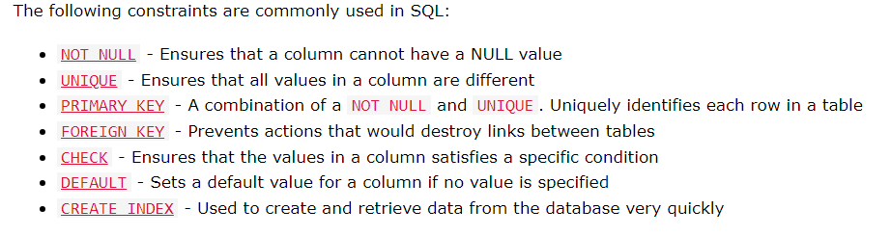
Constraints

Slide 107
Not Null Example:
CREATE TABLE public."Users" ( "UserID" integer NOT NULL, "Username" character varying(20), "Email" character varying(45), "Password" character varying(45), "CreatedAt" time with time zone, PRIMARY KEY ("UserID") );

Slide 108
Not Null Example:
ALTER TABLE public."UsersTest" ALTER COLUMN "testUsers" SET NOT NULL;

Slide 109
Unique Example:
CREATE TABLE public."UsersTest"
(
"UserID" integer NOT NULL,
"Username" character varying(20) UNIQUE,
"Email" character varying(45),
"Password" character varying(45),
"CreatedAt" time with time zone,
PRIMARY KEY ("UserID")
);

Slide 110
Unique Example:
ALTER TABLE public."UsersTest" ADD UNIQUE ("Email" ) ;

Slide 111
Primary Key Example:
CREATE TABLE public."Users" ( "UserID" integer NOT NULL, "Username" character varying(20), "Email" character varying(45), "Password" character varying(45), "CreatedAt" time with time zone, PRIMARY KEY ("UserId") );

Slide 112
Primary Key Example:
It will be not null automatically, since it is primary key.
ALTER TABLE public."UsersTest" ADD PRIMARY KEY ("UserID" ) ;

Slide 113
Foreign Key Example:
CREATE TABLE public."UserConversationTest"
(
"UserID" integer ,
"ConversationName" character varying(50),
FOREIGN KEY ("UserID") REFERENCES public."Users"("UserID")
);

Slide 114
Foreign Key Example:
ALTER TABLE public."UserConversationTest" ADD FOREIGN KEY ("UserID" ) REFERENCES public."Users"("UserID");

Slide 115
Check Example:
CREATE TABLE public."Persons“ ( "ID" integer PRIMARY KEY, "Age" integer CHECK("Age">18) );

Slide 116
Check Example:
If there is violate data for check rule, it gives error
ALTER TABLE public."Persons" ADD CHECK("Age">18);

Slide 117
Default Example:
CREATE TABLE public."Persons“ ( "ID" integer PRIMARY KEY, "Age" integer DEFAULT(18) );

Slide 118
Default Example:
ALTER TABLE public."Persons" ALTER COLUMN "Age" SET DEFAULT(18);

Slide 119
Index Example:
Indexes are used to retrieve data from the database more quickly than otherwise.
Note: Updating a table with indexes takes more time than updating a table without (because the indexes also need an update). So, only create indexes on columns that will be frequently searched against.

Slide 120
Index Example:
CREATE INDEX myIndex ON public."Persons" ("ID","Age"); -- it converted myindex
CREATE INDEX "myIndex" ON public."Persons" ("ID","Age"); -- it did not convert myindex

Slide 121
Drop Index Example:
DROP INDEX "myindex";
DROP INDEX "myIndex"; --error

Slide 122
Auto Increment Example:
CREATE TABLE public."Students“ ("ID" SERIAL NOT NULL , "Username" character varying(20), "Email" character varying(45), "Password" character varying(45), PRIMARY KEY ("ID") );
CREATE SEQUENCE id_sequence start 1 increment 1;
INSERT INTO public."Students"
VALUES(nextval('id_sequence'),'Clara','clara@example.com','pass321');

Slide 123
Date
SELECT NOW();
SELECT NOW()::date;
SELECT CURRENT_DATE;

Slide 124
View
CREATE VIEW view_name AS SELECT column1, column2, ... FROM table_name WHERE condition;

Slide 125
View Example:
CREATE VIEW getUsers AS SELECT * FROM public."Users";
SELECT * FROM getUsers;

Slide 126
Injection
SQL injection is a code injection technique that might destroy your database.
SQL injection is one of the most common web hacking techniques.
SQL injection is the placement of malicious code in SQL statements, via web page input.

Slide 127
SQL in Web Pages
txtUserId = getRequestString("UserId"); //User Input txtSQL = "SELECT * FROM Users WHERE UserId = " + txtUserId;

Slide 128
SQL Injection Based on 1=1 is Always True
If there is nothing to prevent a user from entering "wrong" input, the user can enter some "smart" input like this:
UserId: 105 OR 1=1
Then, SELECT * FROM Users WHERE UserId = 105 OR 1=1;
return ALL rows from the "Users" table, since OR 1=1 is always TRUE. (dangerous)

Slide 129
Solution (ASP.NET Razor Example):
txtUserId = getRequestString("UserId"); txtSQL = "SELECT * FROM Users WHERE UserId = @0"; db.Execute(txtSQL,txtUserId);

Slide 130
Hosting:
If you want your web site to be able to store and retrieve data from a database, your web server should have access to a database-system that uses the SQL language.
If your web server is hosted by an Internet Service Provider (ISP), you will have to look for SQL hosting plans.
The most common SQL hosting databases are MS SQL Server, Oracle, MySQL, and MS Access.

Slide 131
Data Types:
https://www.w3schools.com/sql/sql_datatypes.asp

